Slide 1






Gene Expression EDA
By Pitipat Gumphusiri

Slide 2

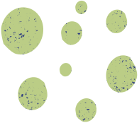
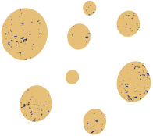
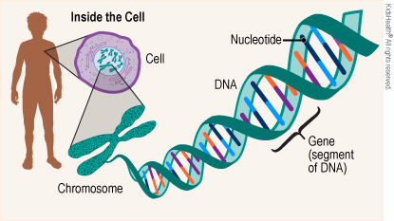
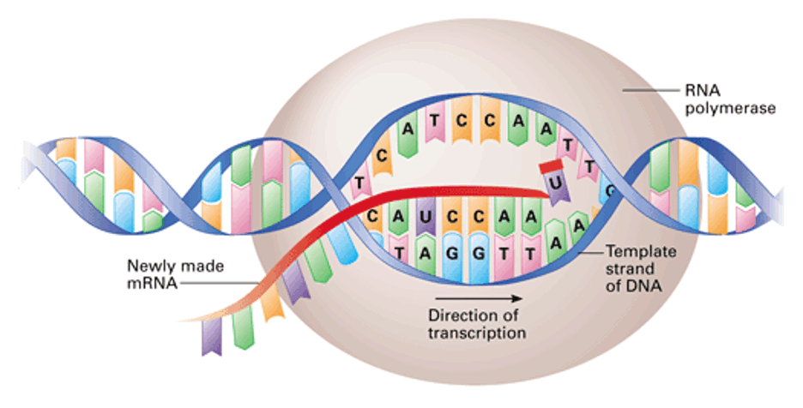

Human Biology
Gene
Gene Expression
mRNA then creates a protein that perform various functions in our body

Slide 3
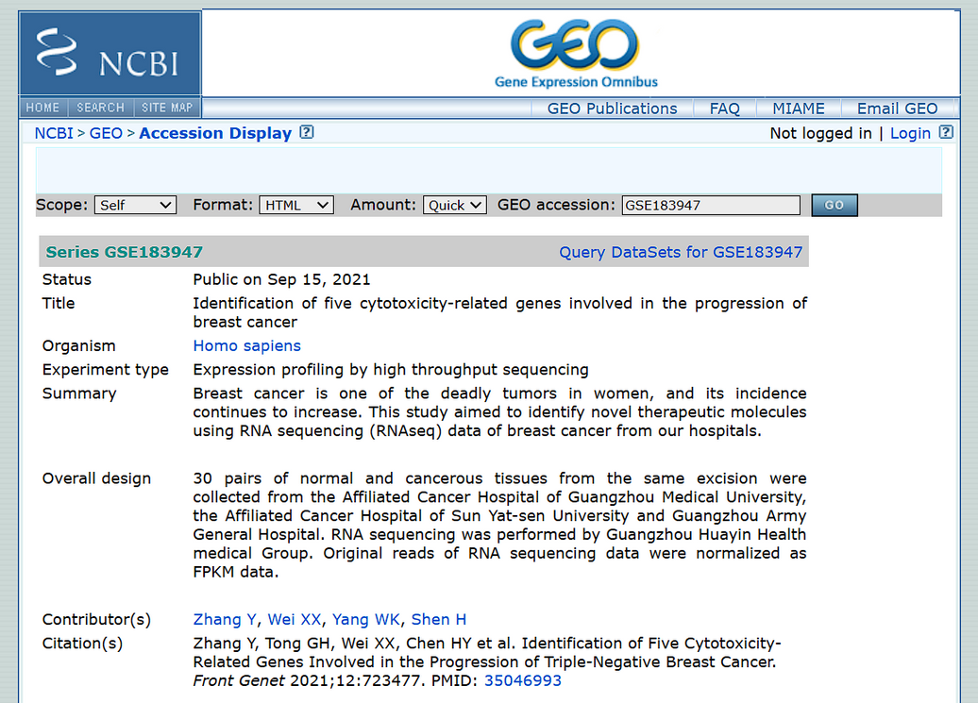

Dataset
Gene Expression of Normal and Breast Cancer Tissue
Total 60 samples
Conducted in 2021
Hospital of Guangzhou University of Chinese Medicine

Slide 4
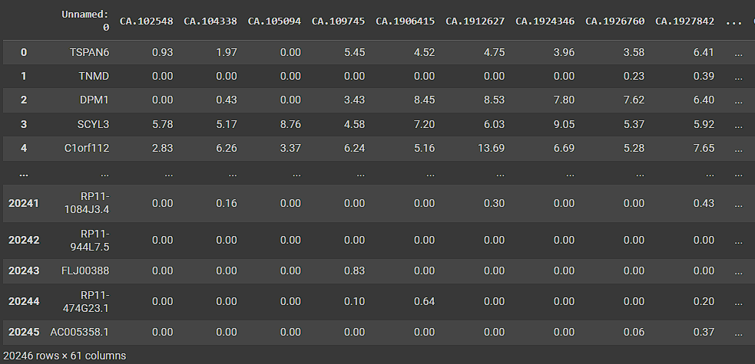
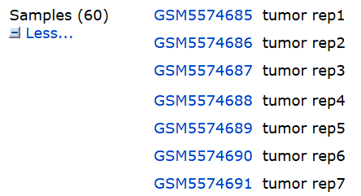
Raw Data
Samples ID
Gene names
FPKM Value
“Tell how much each gene are active”

Slide 5
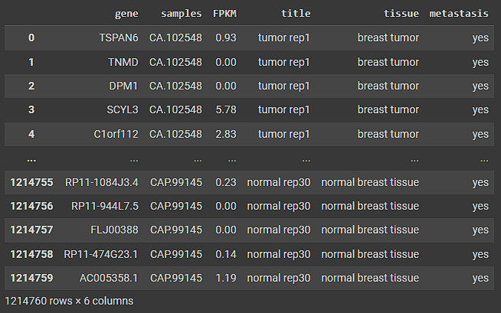
Prepocessed Data
Tells whether there are signs of cancer spreading throughout the body
Summary
Data collected from 15 metastasis and 15 non-metastasis breast cancer patients (both cancer and normal tissue, result in 60 samples)
20246 gene expression is measured by FPKM value on each sample
60 x 20246 = Total 1,214,760 rows

Slide 6


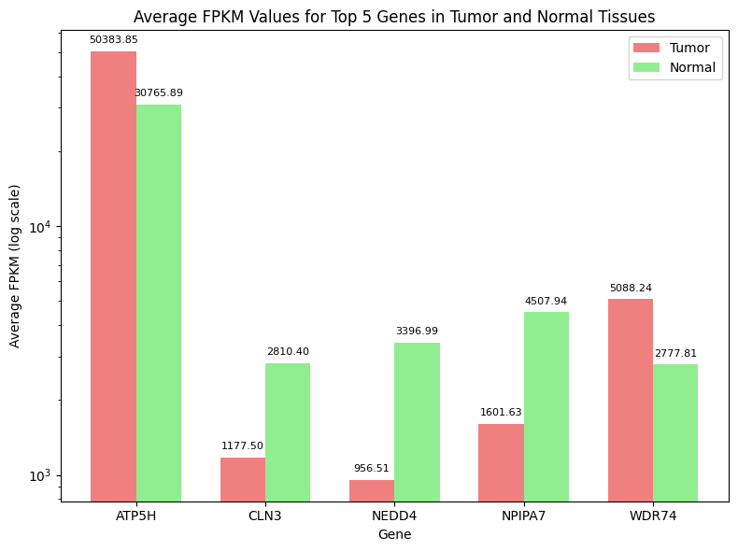


Q1
Which are the most highly expressive genes?
Energy production
Influencing tumor formation and metastasis in melanoma (Skin cancer).
Hormone signaling
Regulates membrane proteins
Recycling components within the cell

Slide 7
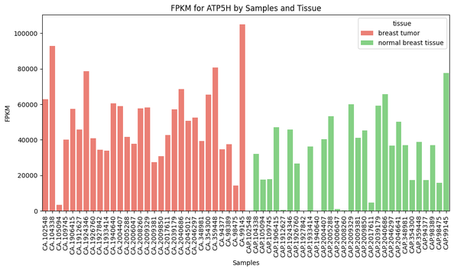
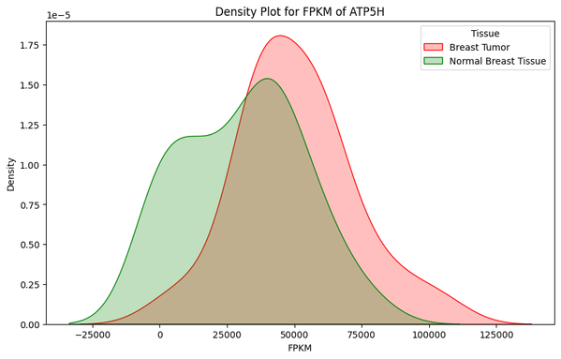
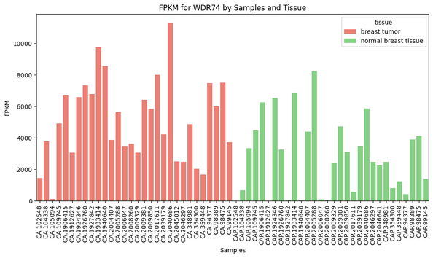
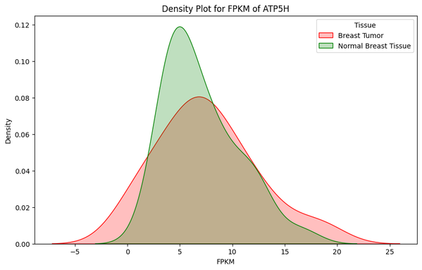
ATP5H - Energy production
Q2
WDR74 - Influencing tumor formation and metastasis in melanoma (Skin cancer).
What are the distributions of samples in top expressive genes?
This data suggest that WDR74 also potentially Influencing tumor formation in Breast cancer

Slide 8
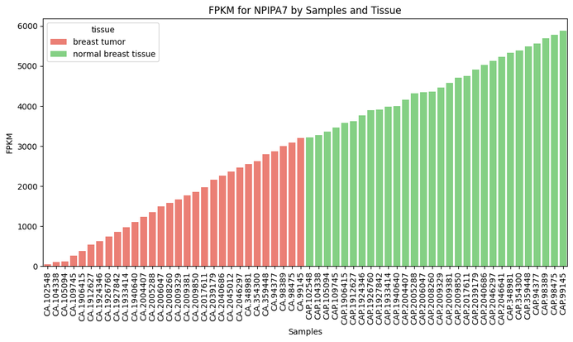
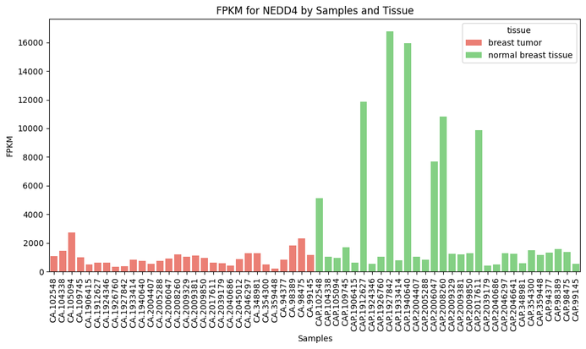
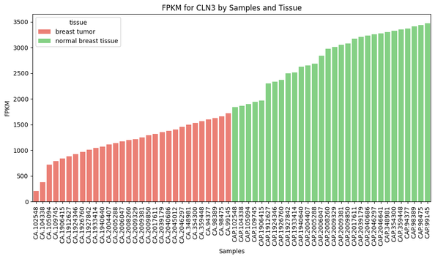
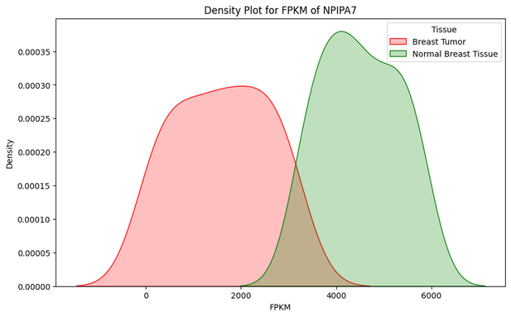
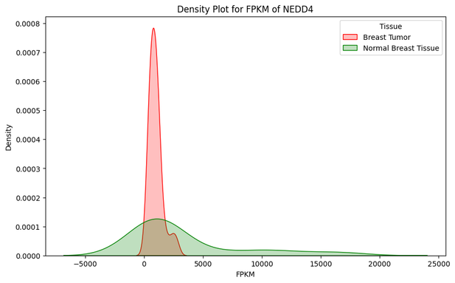
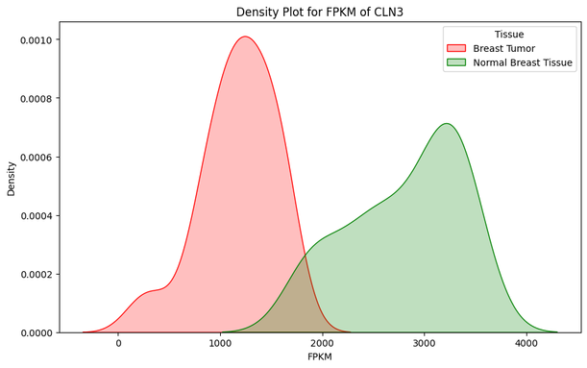
Q2
NPIPA7 - Hormone signaling
NEDD4- regulates membrane proteins
CLN3 - recycling components within the cell

Slide 9
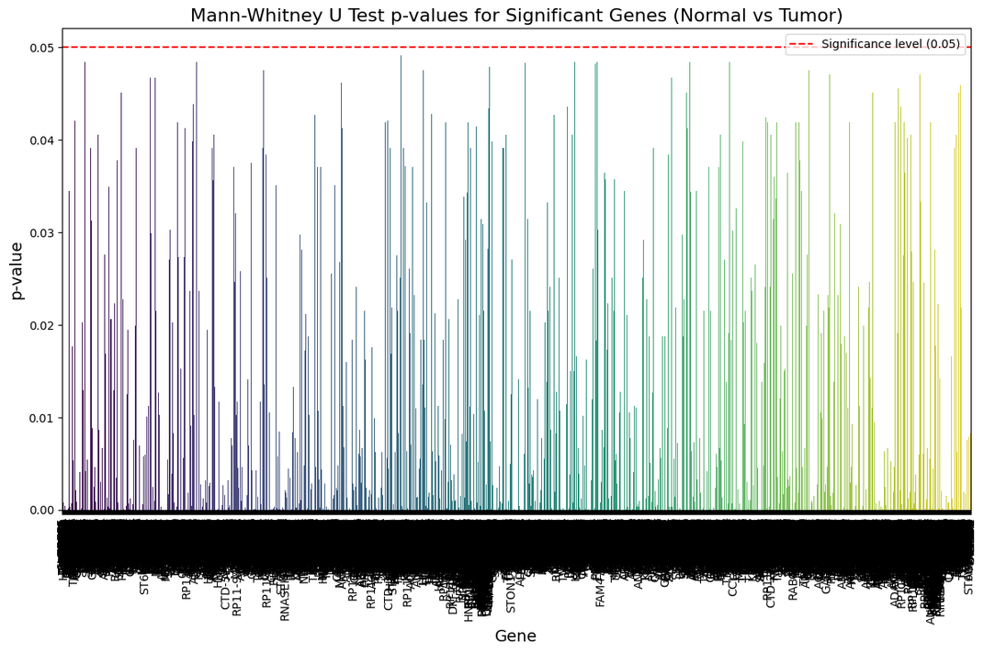
Q3
Which genes have a significant expression difference between normal and tumor group.
Total 8498 statistically significant gene

Slide 10
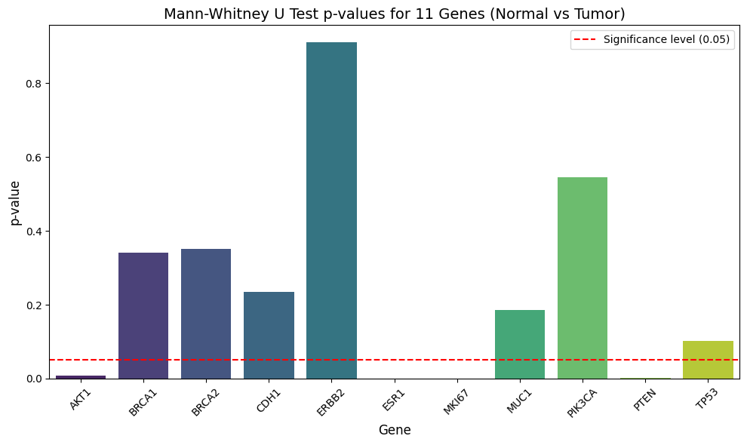
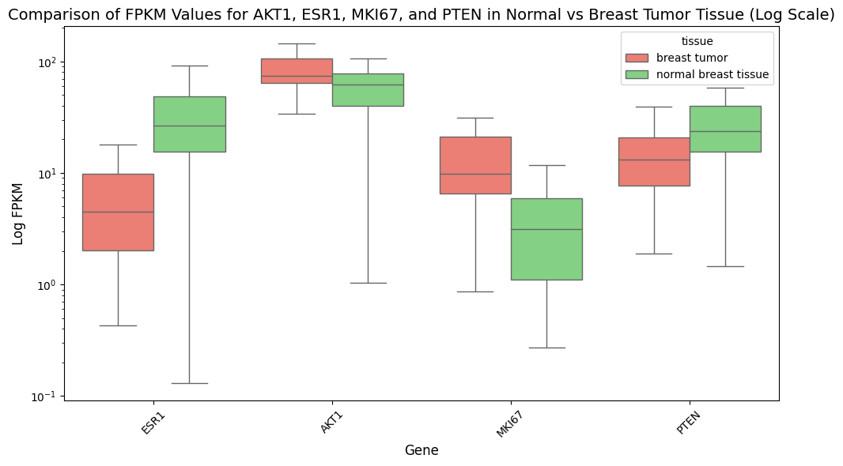
Q3
Common genes related to breast cancer
Estrogen receptor
Support cell survial
Support cell division
Regulate cell division

Slide 11
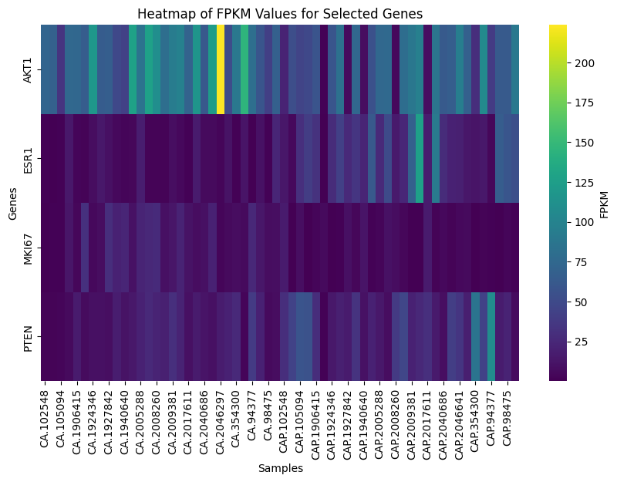
Q4
What are the correlation between significant genes

Slide 12
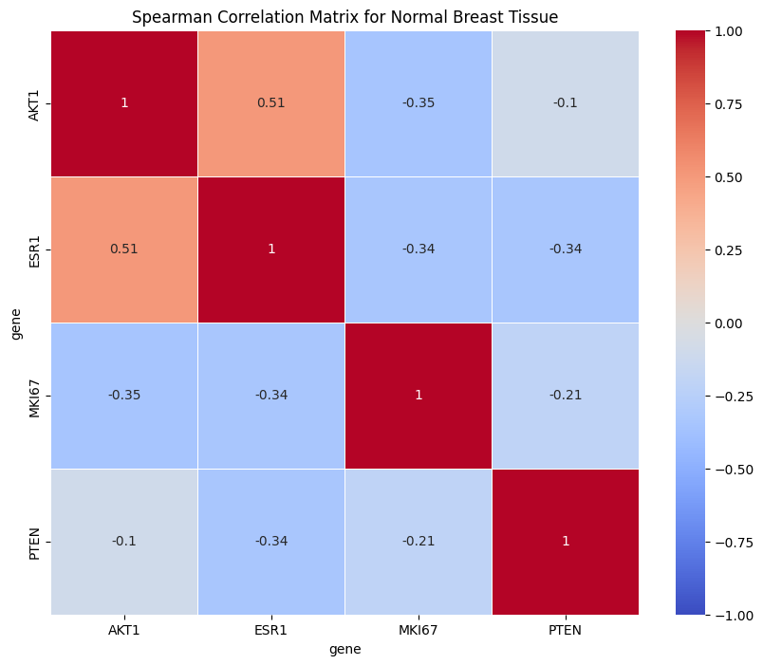
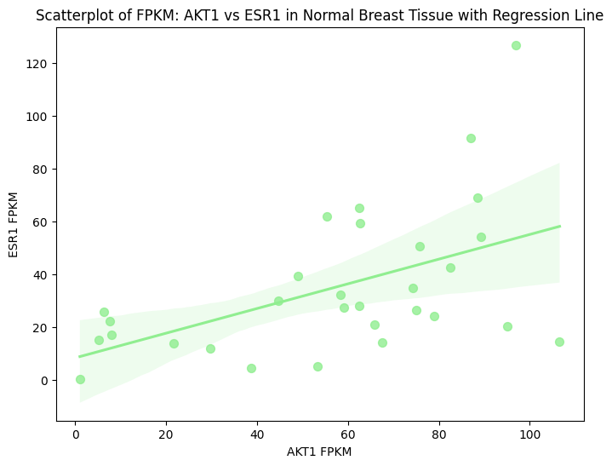
Q4
Support cell survial
Estrogen receptor
Support cell division
Regulate cell division
AKT1 and ESR1 show a moderate positive correlation
Cell survival and Estrogen receptor correlation show normal breast tissue development

Slide 13
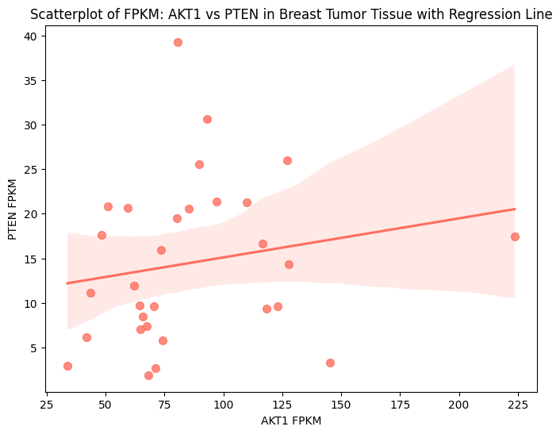
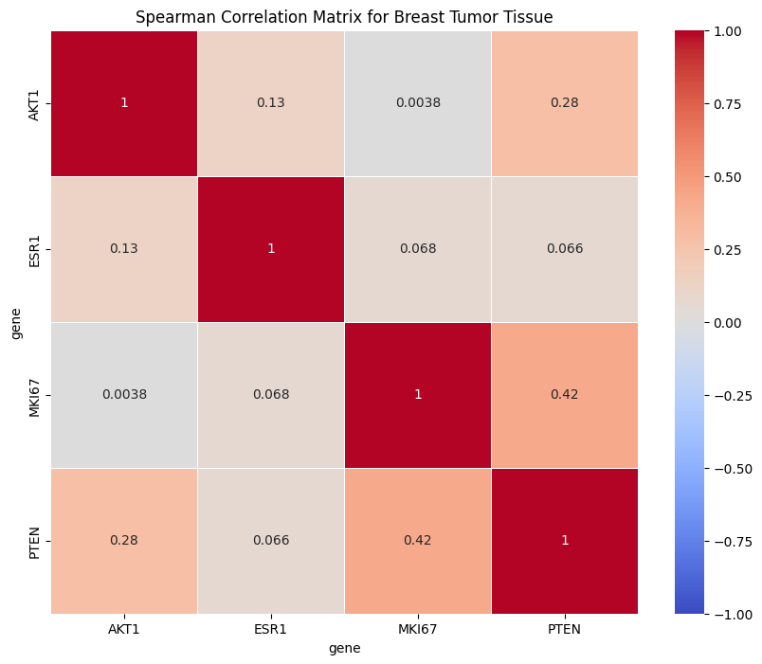
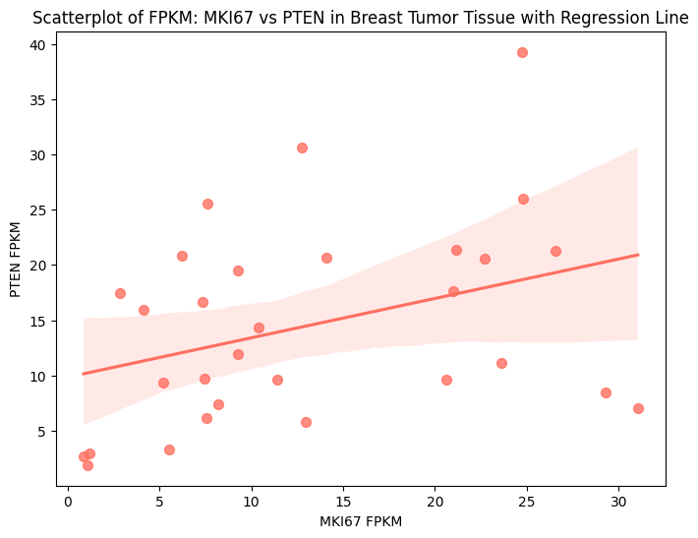
Q4
Support cell survial
Estrogen receptor
Support cell division
Regulate cell division
Diminished correlation between AKT1 and ESR1
(AKT1 and PTEN) , (MKI67 and PTEN) show moderate positive correlation
(AKT1 and PTEN) , (MKI67 and PTEN) positive correlation shows cell division regulator are increasing along with cell growth and division

Slide 14
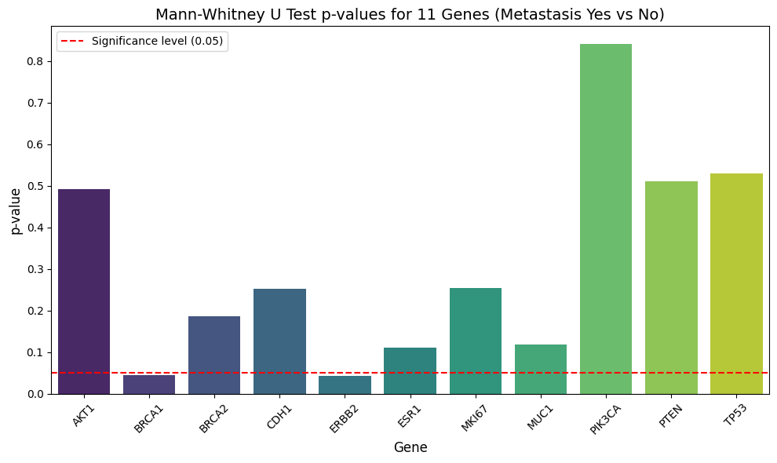
Q5
Which genes have a significant expression difference between metastasis and non-metastasis group.

Slide 15
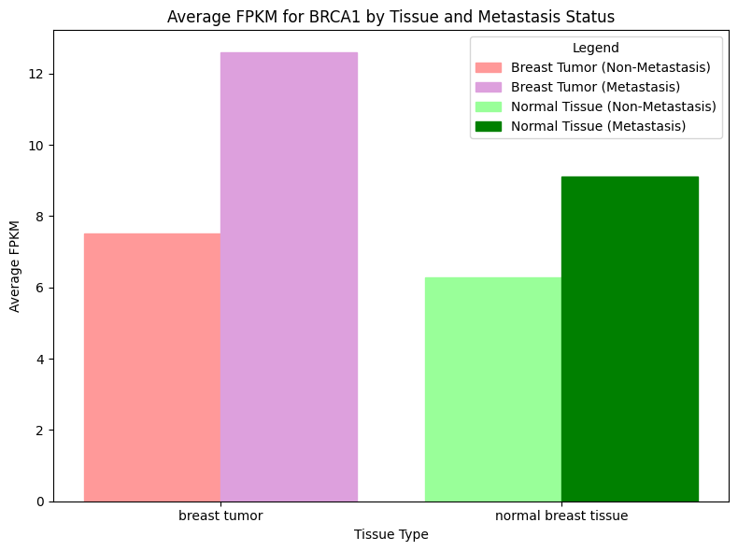
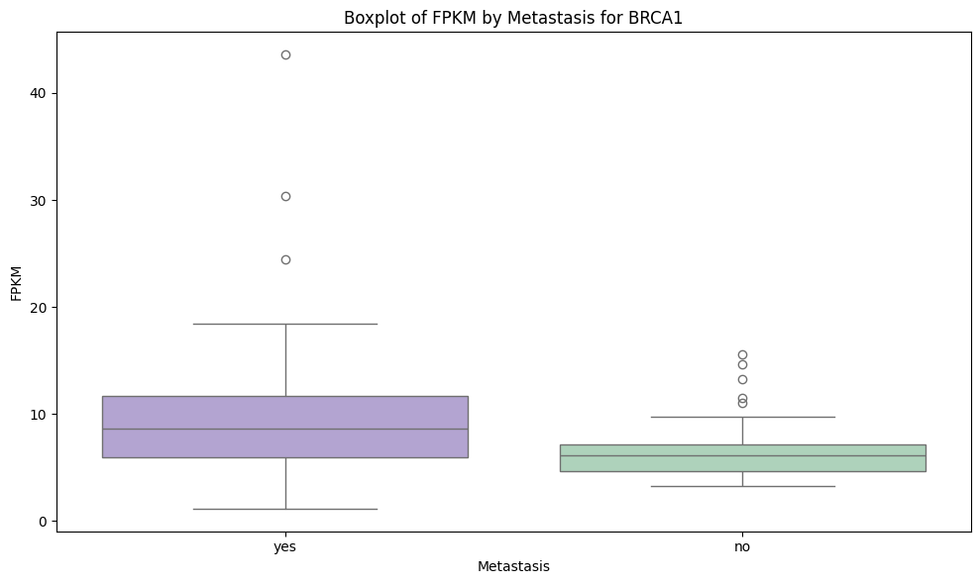
Q5
BRCA1, a Tumor suppressor
High BRCA1 in the Metastasis group might shows a contribution to suppress metastasis

Slide 16
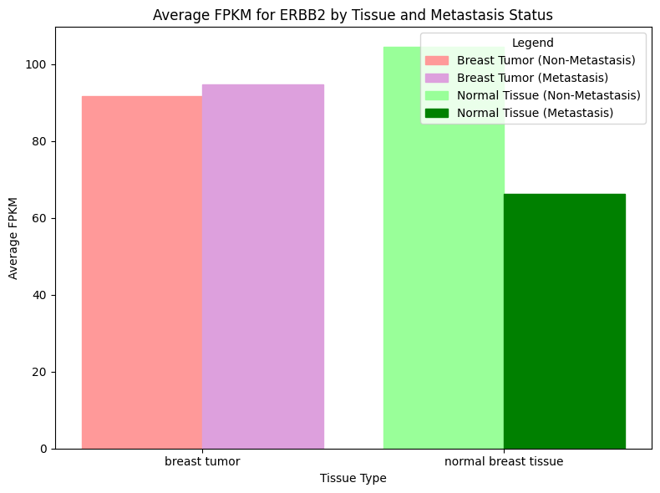
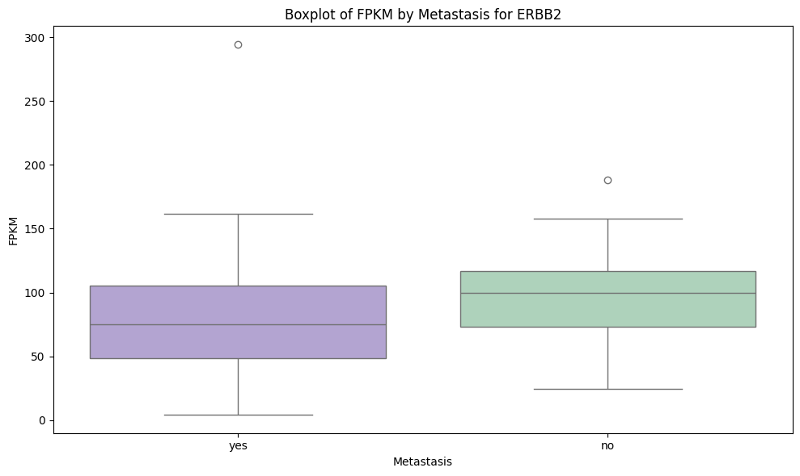
Q5
ERBB2, a cell growth factor
ERBB2 reduces significantly in normal tissue with metastasis
shows that normal tissue growth might become slower when metastasis cancer is present in the body

Slide 17

Conclusion
Gene expression analysis helps us understand how much each gene functions are turned on or off under different conditions
Key Benefits in Various Fields:
Disease Understanding: Provides insights into molecular changes, and specific genes driving cancer development.
Drug Development: Pinpoints critical genes that may serve as potential drug targets, facilitating more precise and effective treatments.
Personalized Medicine: Allows treatment customization based on an individual's unique gene expression profile.
CRISPR and Gene Editing: Validates and explores gene roles, supporting the advancement of gene editing technologies tailored to specific disease profiles.

Slide 18

Thank
you!

